Slide 1
Linux Gaming

Slide 2
Why Game on LInux
If you are using Linux as your daily driver then you don’t need to switch to restart and switch to Windows to game.
Some games give better performance in Linux
Growing support for Linux because of Steam and Google Stadia
Less space for OS means more space for games

Slide 3
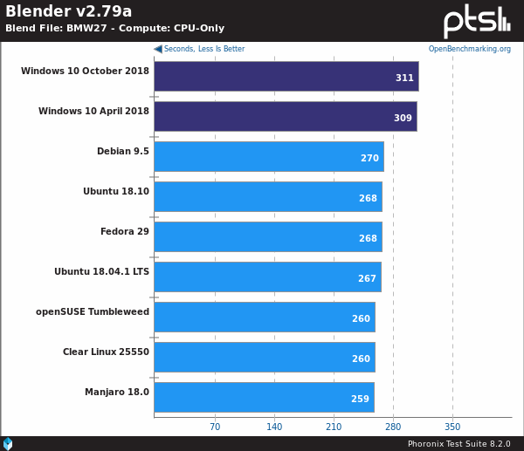
Blender Render

Slide 4
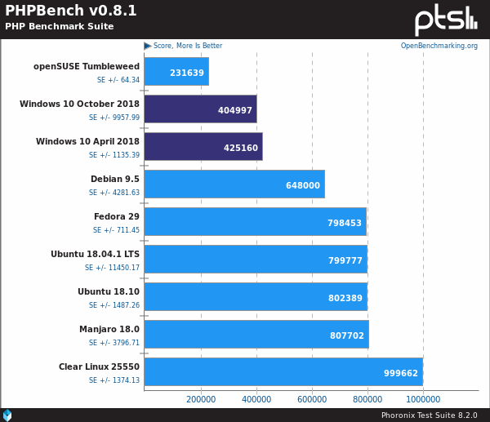
PHP Benchmark

Slide 5
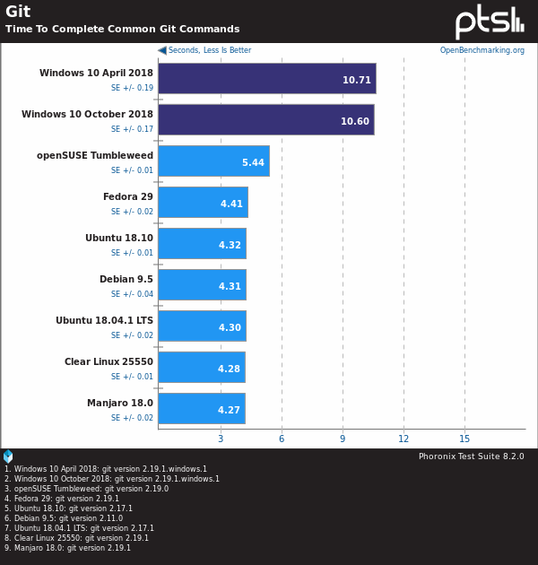
GIT Benchmark

Slide 6
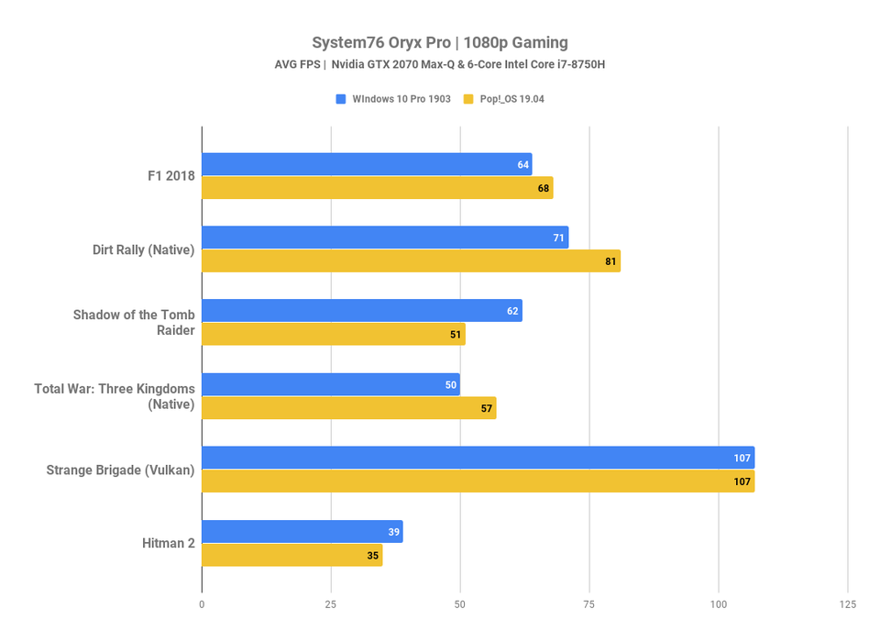
Gaming Performance

Slide 7
Which Distros are Best for Gaming ?

Slide 8
Pop!_OS
Great support for Nvidia graphics cards
Has preinstalled Graphics drivers
Ability to switch graphics
Great support from developers
Made by a hardware manufacturer so greater hardware compatibility
Great battery managment

Slide 9
Manjaro
Based on Arch Linux so it has latest drivers and software
Comes pre-installed with Steam
Automatically detects configuration of machine and installs necessary drivers

Slide 10
What is Steam
Steam is a marketplace for games similar to Flipkart or Amazon
It is also acts as community forum, you can find system requirements, fan art and MODs all in same place
Has a huge library of Free and Paid
Has 3 annual sales with huge discounts on games

Slide 11
How to Install Steam ?
Go to terminal
Type ‘sudo apt install steam’
Hit enter
Voila! Steam will begin downloading and installing

Slide 12
What is Proton
Proton is a compatibility tool based on wine which lets you play windows exclusive games on Linux.

Slide 13
How to enable Proton
Open Steam
Go to settings
Go to Steam Play
Click on enable Steam Play for all tittles

Slide 14
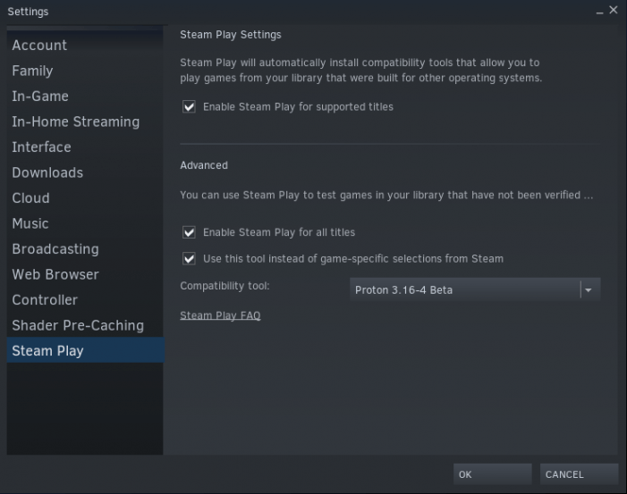

Slide 15
What is ProtonDB
It gives reviews on how well does a game run with proton
There is information about reviewer’s machine and distro
There are also some useful tips for possible problok sir

Slide 16
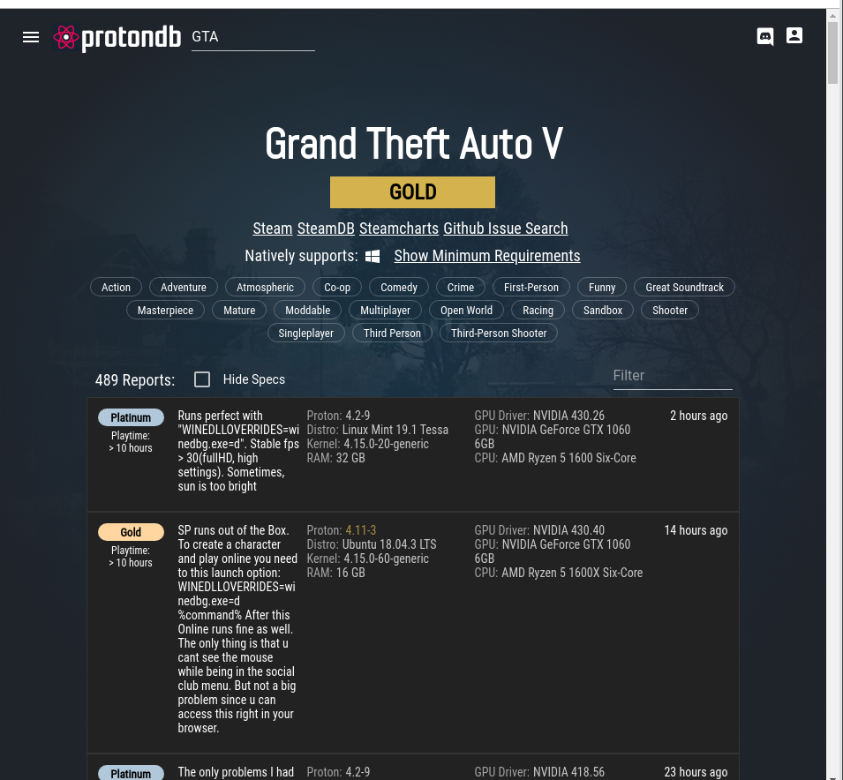

Slide 17
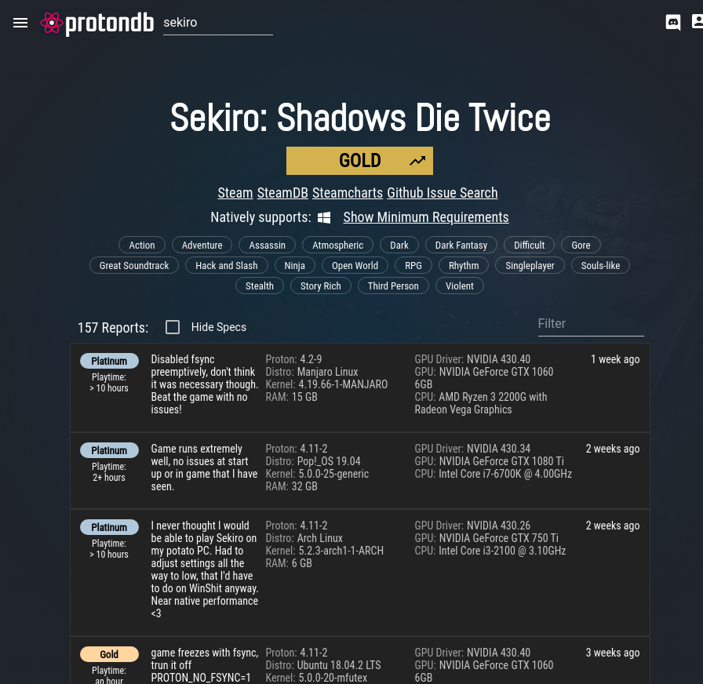

Slide 18
Top Free Game on Linux
DOTA 2 – A real time strategy game
Team Fortress 2 – First Person Shooter game basically overwatch before overwatch
War Thunder – multiplayer game based on tank and air warfare during WW2
Brain/Out – 2D like Mini Militia but with more depth and variety
CSGO

Slide 19
Lutris
Some titles which are not available on Steam are available on Lutris
Lutris is also based on wine but takes care of a lot of hassle

Slide 20
Linux Customization

Slide 21
How Customizable is Linux
A simple answer: A LOT !!!!!!
You can go as deep as you want
But today wee will be looking at a simple but powerful tool for Gnome desktop environment

Slide 22
Gnome Tweaks Tool
It gives you a lot of control over your desktop environment
You can configure startup applications, input methods and appearance

Slide 23
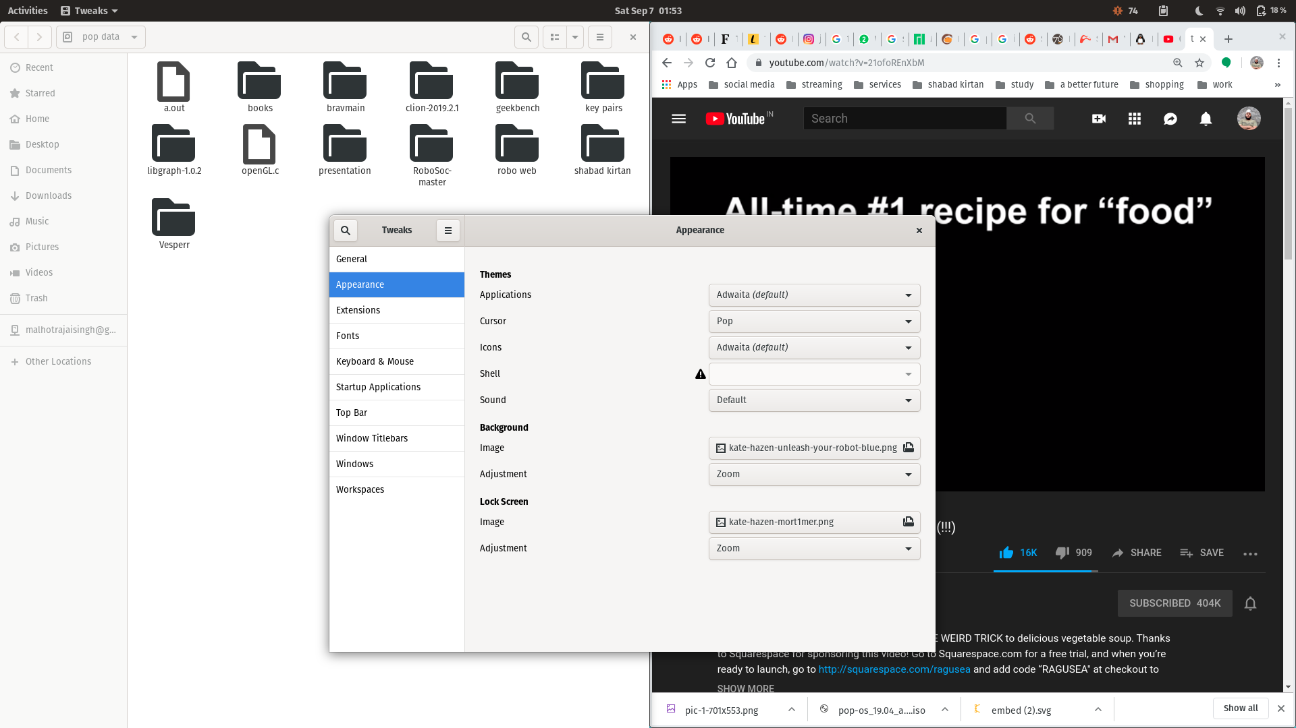

Slide 24
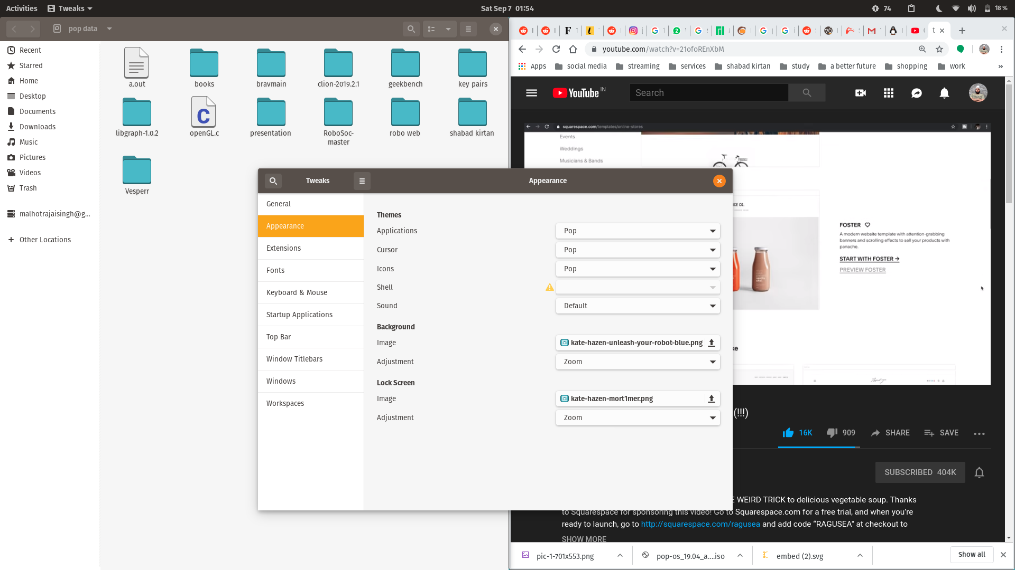

Slide 25
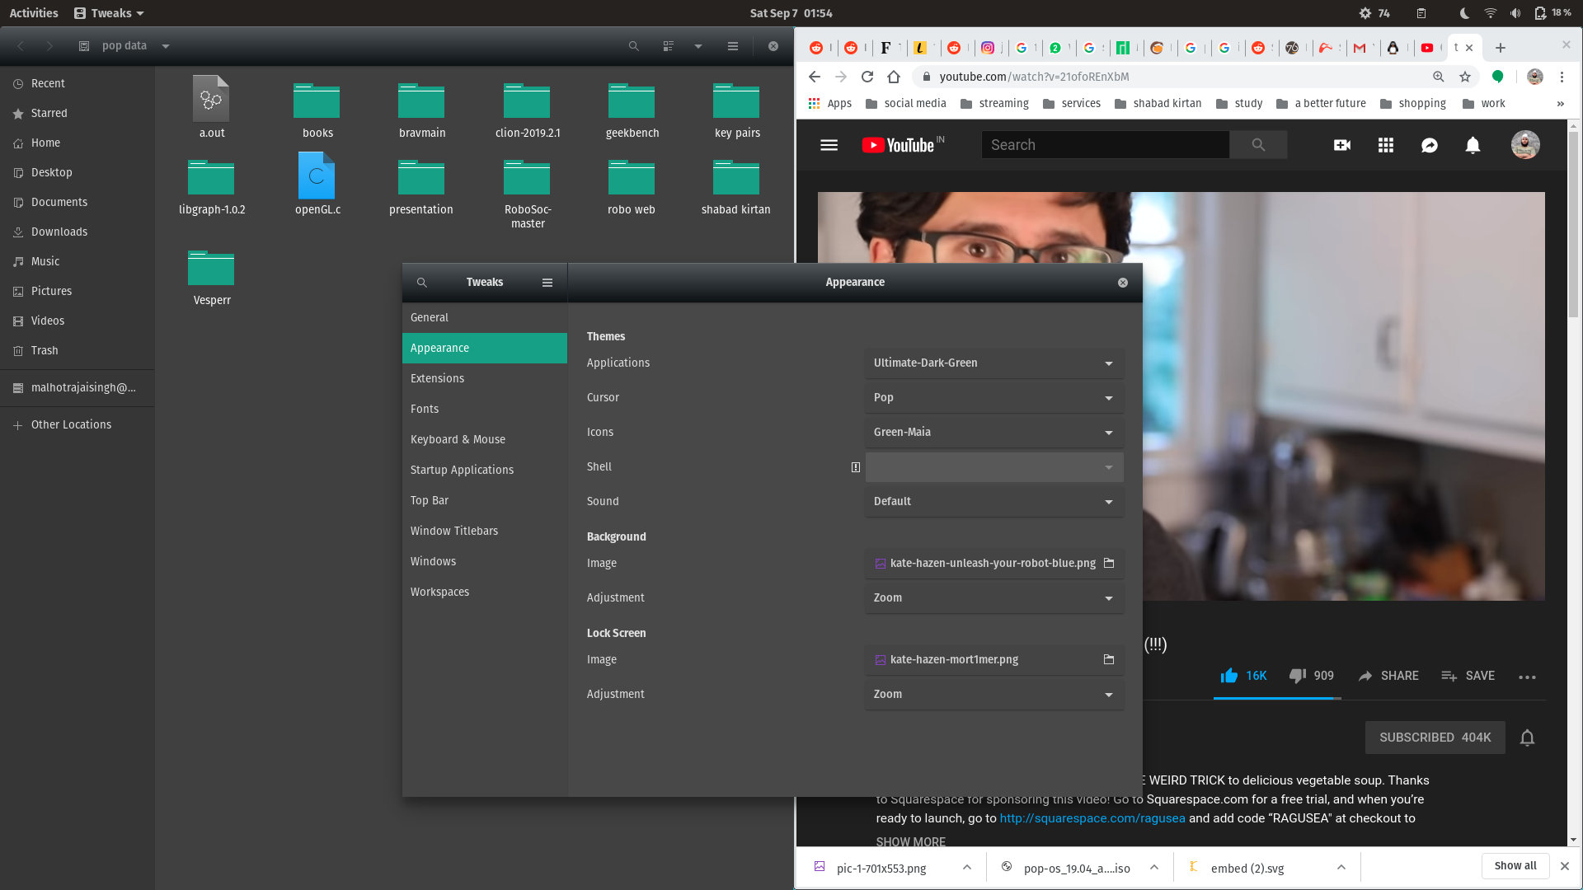

Slide 26
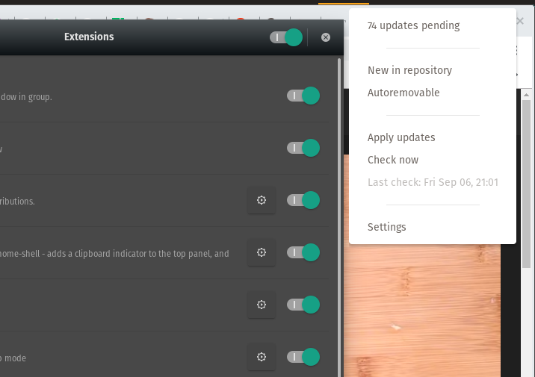

Slide 27
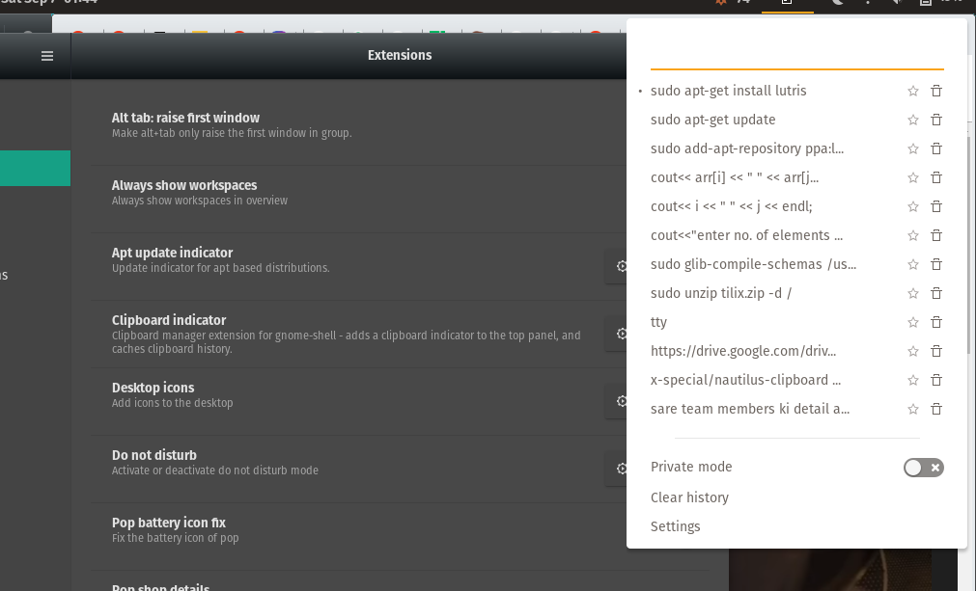

Slide 28
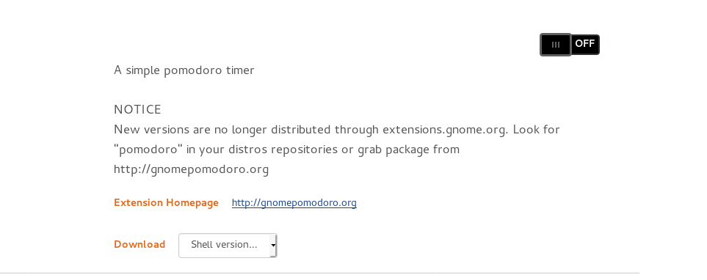

Slide 29
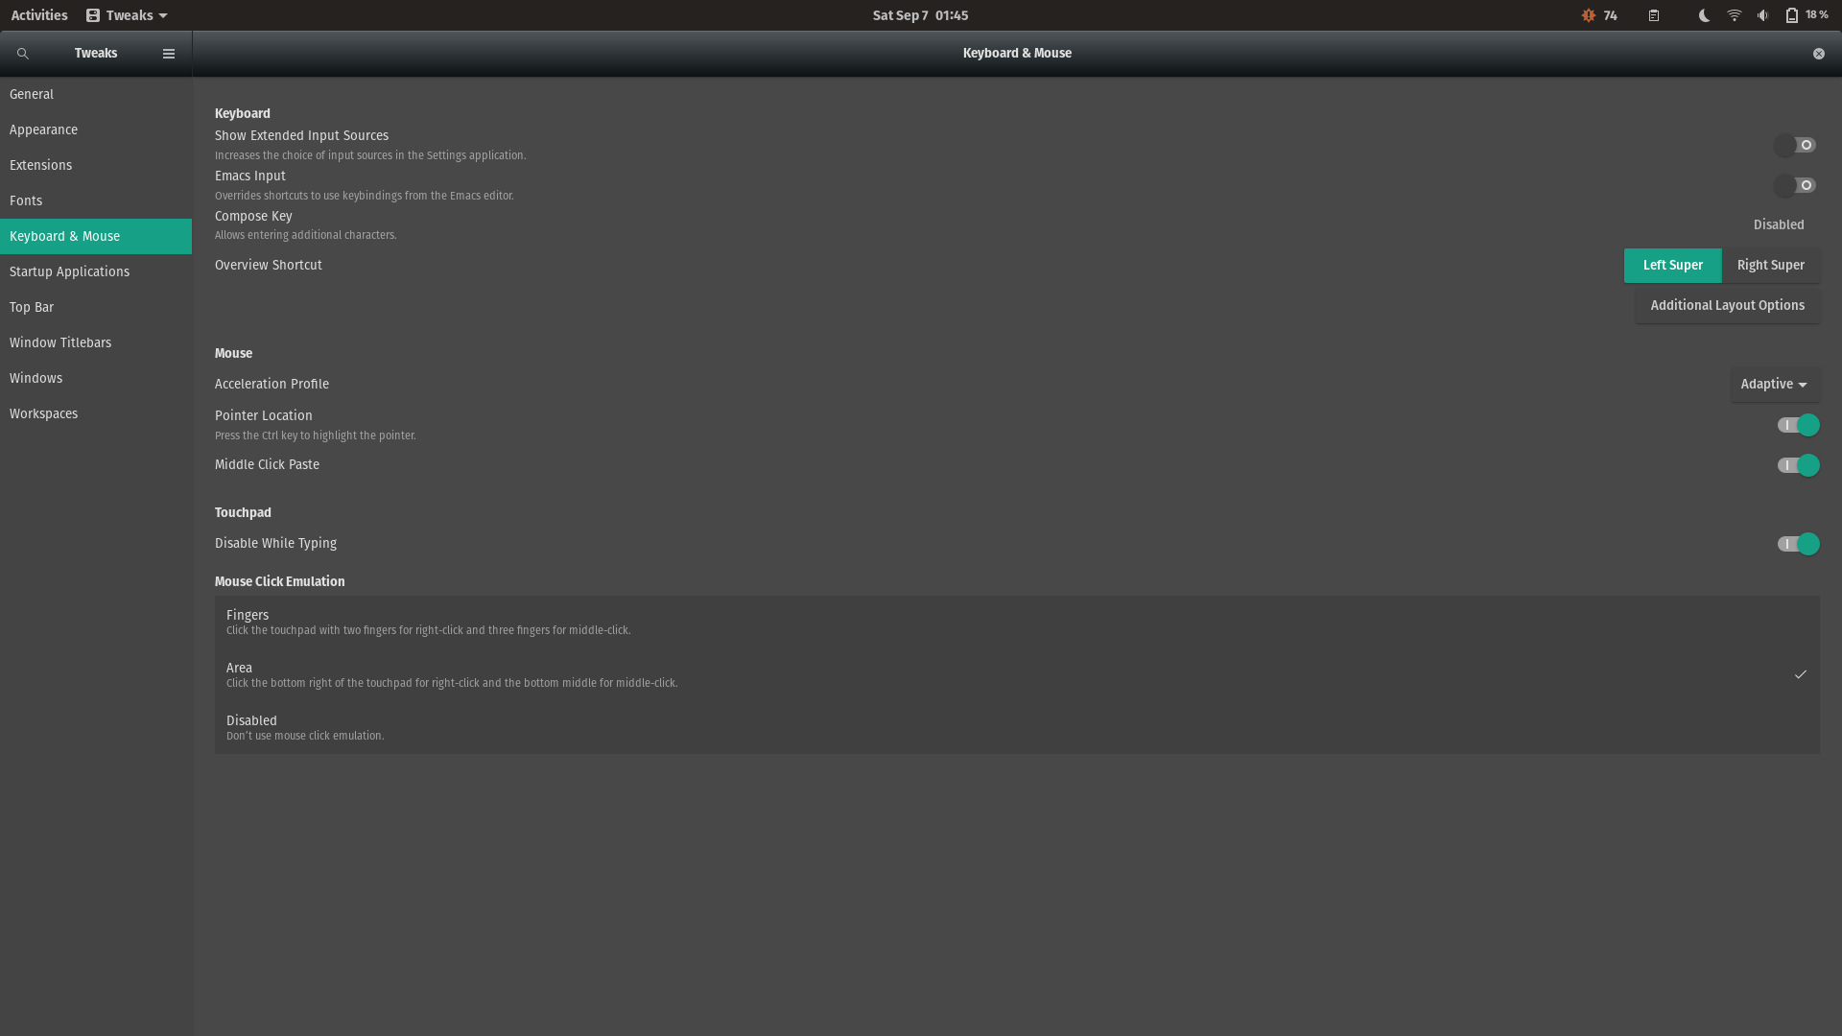

Slide 30
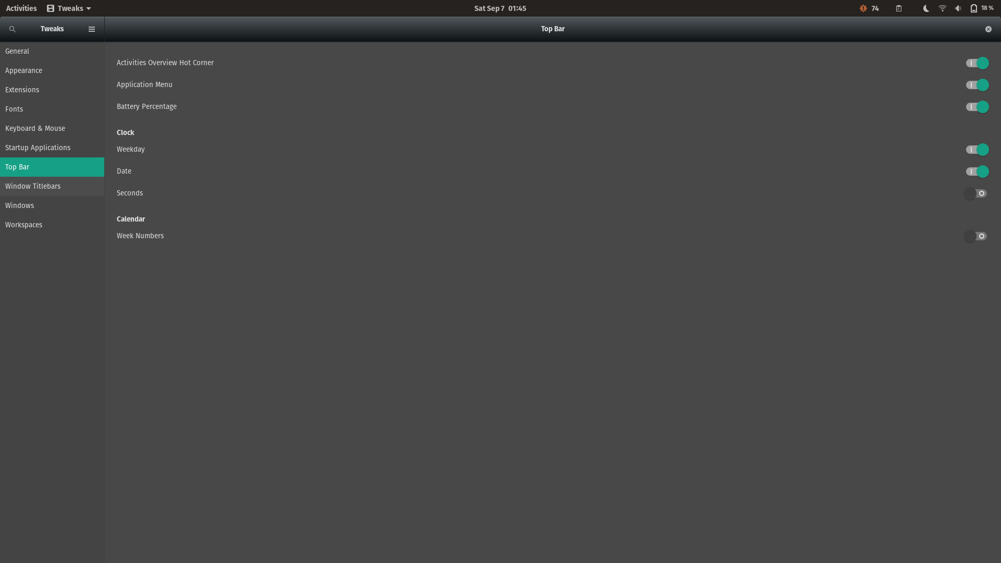

Slide 31
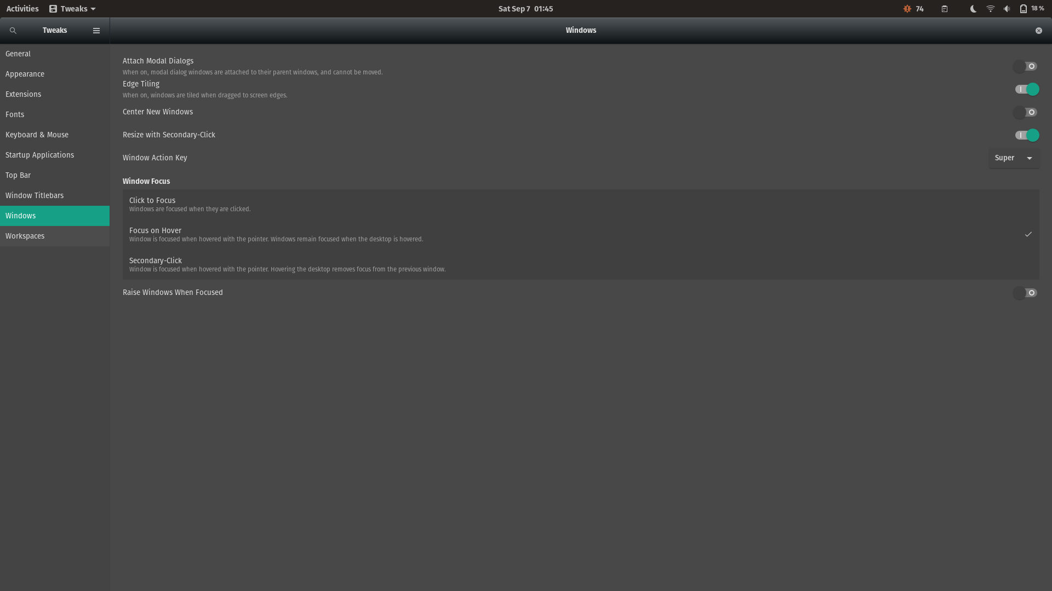

Slide 32
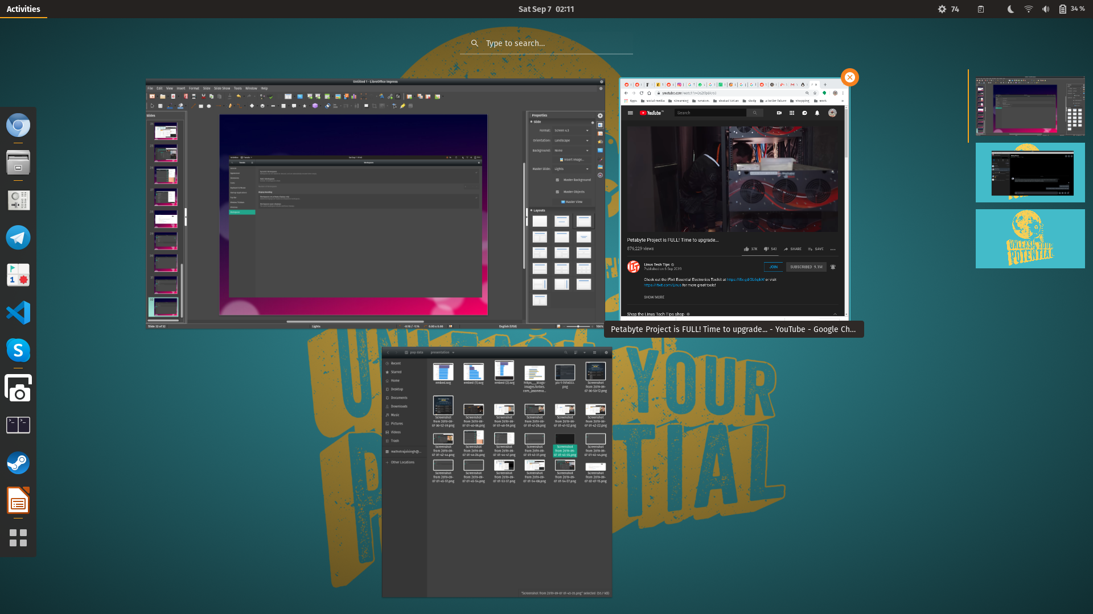

Slide 33
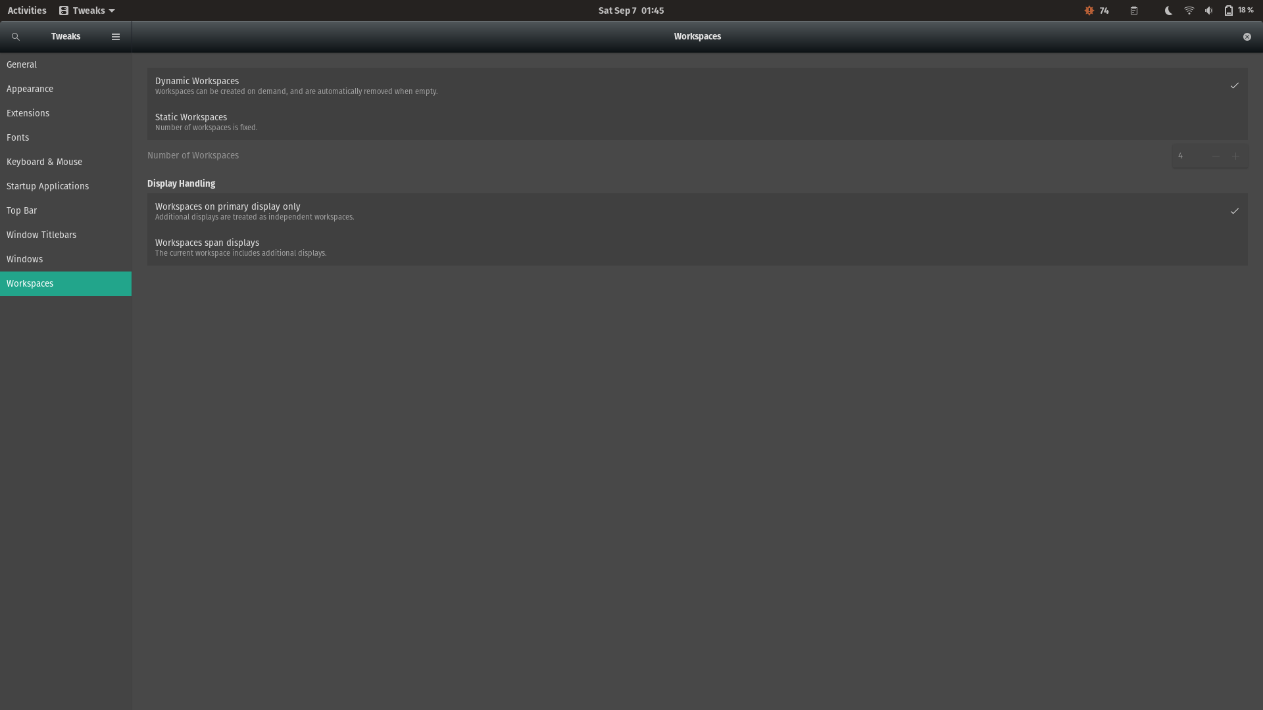

Slide 34
THANK YOU!!
ALAKH NIRANJAN !!

